Slide 1

North South University Department of Electrical & Computer Engineering Project Presentation Fall 2020
Project Title : Online Home Repair System
Submitted By:
Sazzad Hossain --- ID: 1610139042
Prasanto Dey --- ID: 1621310042
Anika Bin Wasim --- ID: 1631297042
Faculty Advisor :
Dr. Mohammad Ashrafuzzaman Khan

Slide 2

Introduction
We are making an Online Home Repair System.
This system will contain all the necessary features on Plumbing Service, Electrical Service, Home Repair Service, Appliance Repair service so that people can solve all their daily home maintenance problems from one platform.
This online maintenance system will save time and money of the consumer by providing all of theirs problems solution at one platform and by setting up reasonable prices.
The goals of the project is to build an online platform where consumer can buy any service anytime anywhere, we can solve service finding problems for both consumer and business owners.

Slide 3
Problem Description and Proposed Solution
Problem Description:
People lead a busy life, especially in the urban areas. So it is not possible for people to stay home by putting off work and wait for serviceman so that they can fix something at their home. There is also fear of overcharge by the serviceman. People face problem . Finding Verified skillful people is also a problem.
Proposed Solution:
Serviceman will register to our platform and after getting approval by providing name, email, phone number, address, and business license they will get work from our platform.
When customer will place order we will notify service providers of that area by sending notification.
If the serviceman choose the service work then we will send address of the customer to the serviceman through message or email.
We will take a percentage from the total amount.
Before joining our platform service workers can see the price we pay for each service.
All of these service will have weekly, monthly and yearly package.
Customer will be able to choose cash on delivery only for daily package.
People can select preferable time and date for home maintenance.

Slide 4
Front End Development
Home Page
Search Result Page
Registration /Login page
Plumbing Service page
Electrical Service page
Home Repair Service page
Appliance Repair service
Checkout Page

Slide 5
Back End Development
(a) Account Creating, Password Recover:
Sign up form, verification by mobile or email.
Login
Facebook login (Phase 2)
Google login (Phase 2)
Forgot Password
MySQL Database
(c) Searching Facilities:
Service category based
Service Price
(b) Profile Management:
DB plan design
Peoples Profile
Company Profile

Slide 6
Development Process
User Interface Design: For front-end development we will use HTML5, CSS3, JavaScript and Bootstrap.
PHP and Database Interaction:
For creating database we will use XAMPP.
We will create a database that will contain all the table and data for our website.
We will link the database tables by PHP files to our website’s pages by connection code created by PHP.
So that service data and related images can be retrieve.
We also will make PHP codes to insert data into database respective tables.
In our login page if an existing user try to login, then the PHP query that we made and connected with database will check the validity of the username and password and if given information is right then user will able to login.

Slide 7
Development Process
Cookies:
Cookies are text files stored on the client computer and they are kept of use tracking purpose for better user experience. PHP transparently supports HTTP cookies. Server script sends a set of cookies to the browser. Browser stores this information on local machine for future use. When next time browser sends any request to web server then it sends those cookies information to the server and server uses that information to identify the user. PHP provided setcookie() function to set a cookie. This function requires up to six arguments and should be called before html tag. For each cookie this function has to be called separately. We will use cookies in our website.
Session:
We will use PHP session to store login info of users. We will start a session with the session_start() function. Session variables are set with the PHP global variable: $_SESSION. To remove all global session variables and destroy the session, we will use session_destroy().

Slide 8
Development Process
API Calls:
We will make two API’s, one is google map and another is money transfer. To build the map we will use google my map option and that will generate an “iframe” tag and we will use that to our site’s pages. For the money transaction from customer we will use a proxy PayPal account and to do this we will open an account and make two proxy email one for personal and one for business. Then we will add pay now button to cart page so that if customers are finish order process then they can pay by their PayPal card.
Responsiveness:
Our website will be web responsive, so it can be accessed from any device.

Slide 9
Use Cases
Use Case Name | Home
Level | User-goal
Primary Actor | End user
Stakeholders and Interest | End user successfully wants to access all the service and their prices and also can order.
Preconditions | Website must be properly connected to online. User is using the website for the first time than he/she have to sign up.
Main Success Scenario | 1. User opens the website. 2. User search for service. 3. User see all services prices and discounts. 4. User order from the website. 5. User successfully log out from website.
Extension | 1a. User cannot see price or do an order, there must be database management problem and system will show an error message
Use Case Name | Searching
Level | User-goal
Primary Actor | End user
Stakeholders and Interest | End user wants to successfully search the website.
Preconditions | User must be logged in. System must be properly connected to online.
Main Success Scenario | User search for needed service. User buy needed services. User successfully logged out from the website.
Extension | 1a.System database not working, the site will stop serving content properly and this happens when database’s disk fills up. 2a. User do not get the content because the content is not uploaded yet.

Slide 10
Use Cases
Use Case Name | Upload file
Level | User goal.
Primary Actor | End user
Stakeholders and Interest | End user wants to upload the file success
Success Guarantee | On successful completion selected file will be uploaded successfully.
Main Success Scenario | User selects database storage. User enters valid database storage credentials.
Extension | 1a. system show an error message for invalid credentials.
Use Case Name | Complete registration
Level | User goal
Primary Actor | End user
Stakeholders and Interest | User will sign up for open an account
Preconditions | 1.user have to connect to the online 2. User have to provide Gmail account or Facebook account to open an account.
Main Success Scenario | User provide Gmail or Facebook account to open website. User verify link send from the website. User can login and see website content and order services. User can successfully log out from the website.
Extension | 1a. user will get error message if the registration information is not right. 1a.1. user re-enters registration information.

Slide 11
Use Cases
Use Case Name | See profile
Level | User goal
Primary Actor | End user
Stakeholders and Interest | User wants to see all services and order them.
Preconditions | User have to log into the website account. User have to connect to the online.
Main Success Scenario | User can edit their information. User gets ordered services to their given address.
Extension | 1a. user won’t be able to see the services and order them due to database connection problem.
Use Case Name | Admin panel
Level | User goal
Primary Actor | End User
Stakeholders and Interest | Can control and operate the website successfully. Can add, delete services
Preconditions | User must be logged in the website and connected to the online.
Main Success Scenario | User can add data User can delete data User can control the service prices. User can delete customer account.
Extension | 1a. User won’t be able to control the website due to database problem.

Slide 12
Use Cases
Use Case Name | User panel
Level | User goal
Primary Actor | End User
Stakeholders and Interest | Can operate the website successfully. Can order services.
Preconditions | User must be logged in the website and connected to the online.
Main Success Scenario | User can add profile data User can delete profile data User can order service. User can delete their account.
Extension | 1a. User won’t be able to control the website due to database problem.
Use Case Name | Serviceman panel
Level | User goal
Primary Actor | End User
Stakeholders and Interest | Can control and operate the website successfully. Can add, delete the services they provide.
Preconditions | User must be logged in the website and connected to the online.
Main Success Scenario | User can take order User can delete order User can delete their work account.
Extension | 1a. User won’t be able to control the website due to database problem.

Slide 13
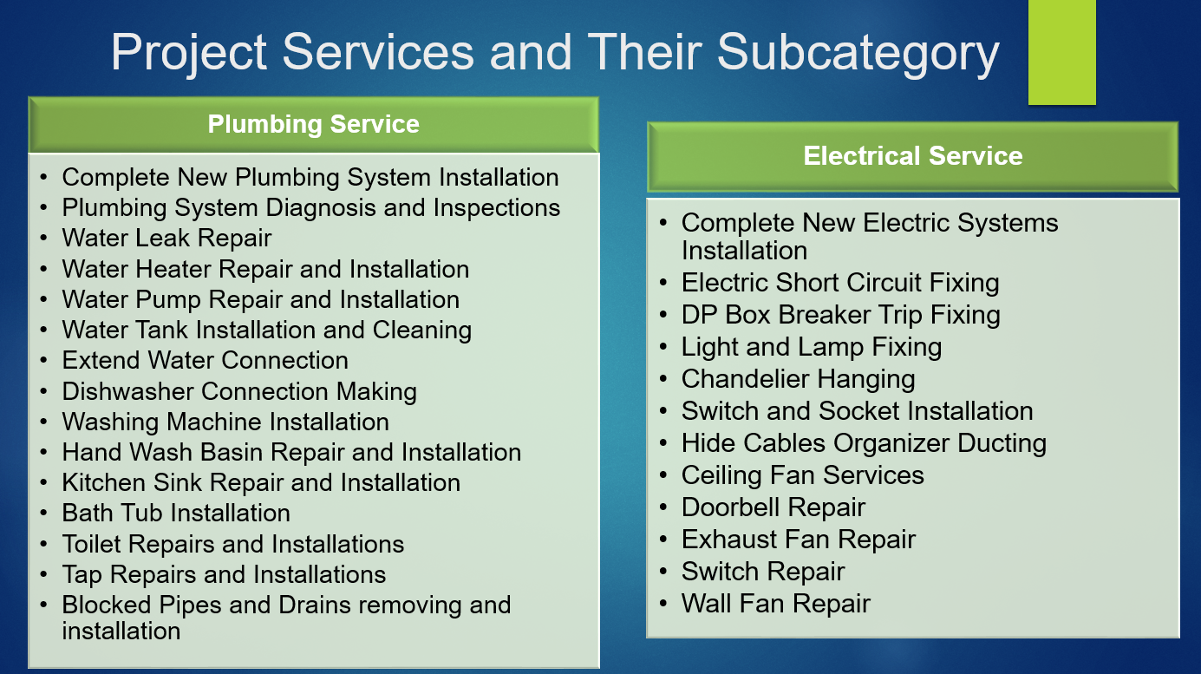

Slide 14
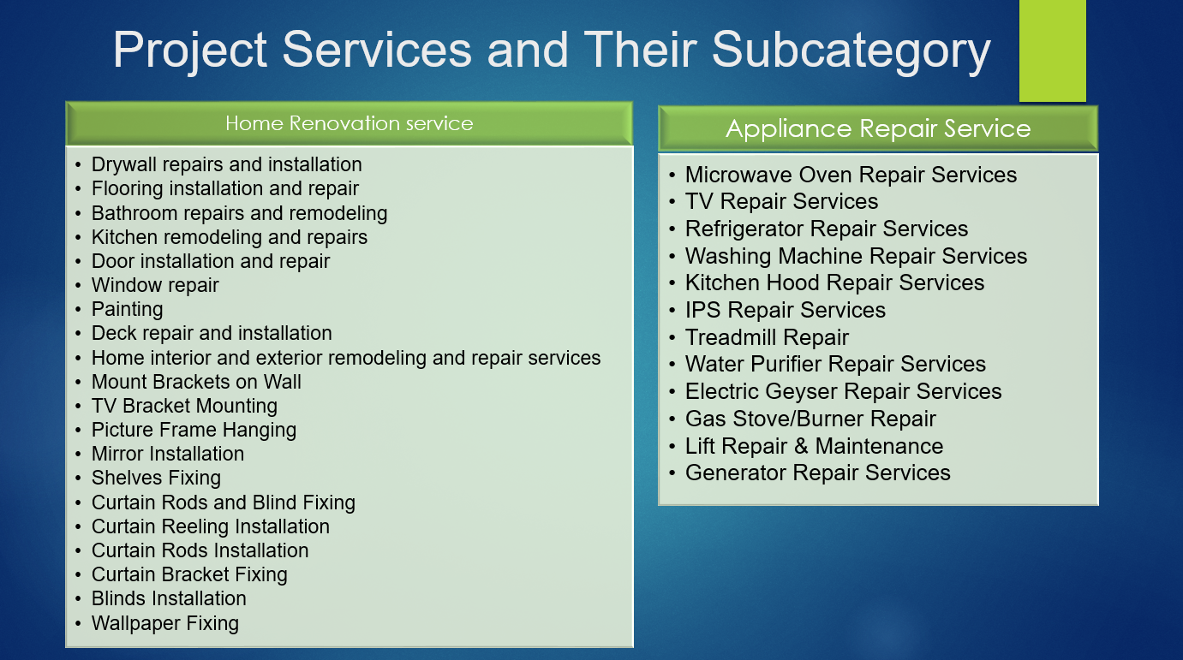

Slide 15
Technologies
Tools:
PowerPoint
UX DESIGN TOOLS (marvel website).
Google classroom(For communication)
GIT
GITHUB
Microsoft word/EXCEL
Atom IDE
Languages:
HTML5
CSS3
PHP
MySQL
JavaScript
Ajax
Bootstrap
Django or Laravel

Slide 16
Project Schedule
 |  | Week |  |  |  |  |  |  |  |  |  |  |  |  |  |  |  |  |  |  |  |  |  | Total Weeks
SL | Deliverable | 1 | 2 | 3 | 4 | 5 | 6 | 7 | 8 | 9 | 10 | 11 | 12 | 13 | 14 | 15 | 16 | 17 | 18 | 19 | 20 | 21 | 22
1 | Front end development*
2 | Profile management
3 | Account management and payment method
4 | Search facility
5 | Deployment and final release |  |  |  |  |  |  |  |  |  |  |  |  |  |  |  |  |  | -
 | Total duration | 5 |  |  |  |  | 5 |  |  |  |  | 5 |  |  |  |  | 4 |  |  |  | 3 |  |  | 22
Deliverables | Color Code
Front end development*
Profile management
Account management and payment method
Search facility
Deployment and final release
No Work

Slide 17
Conclusion
Finding a household service provider at right time can be very difficult. Our online platform will solve these problems by providing skillful people for home maintenance service on time.

Slide 18
References
[1]https://wiki.en.it-processmaps.com/index.php/Project_Management_-_Templates,_Checklists_and_Tips#Project_Initiation_Project_goals
[2] https://deshiz.com/home-service-providers/
[3] https://www.sheba.xyz/#a_aid=5aec94f01d3ec
[4] http://handymama.co/#service
[5] https://www.drooto.com.bd/repair-services-bangladesh/
[6] http://digitalmanush.com/web/
[7] https://www.skillshare.com/home?via=header
[8] https://housedoctors.com/handyman/
[9] https://www.thebalancecareers.com/plumber-skills-list-2062459
[10] http://www.mistribabu.com/handyman.php

